Slide 1

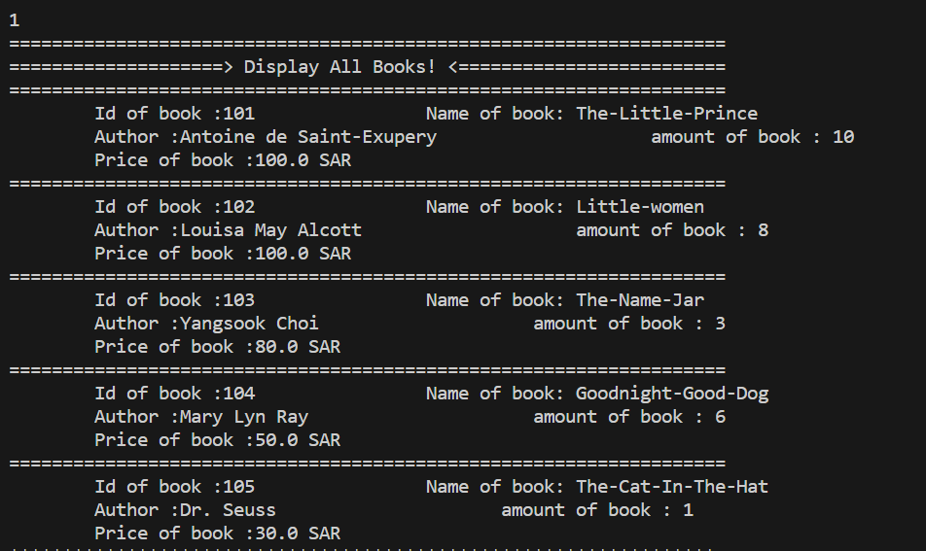
Output:
Menu for Library Management
vShow All Book
Add Book

Slide 2
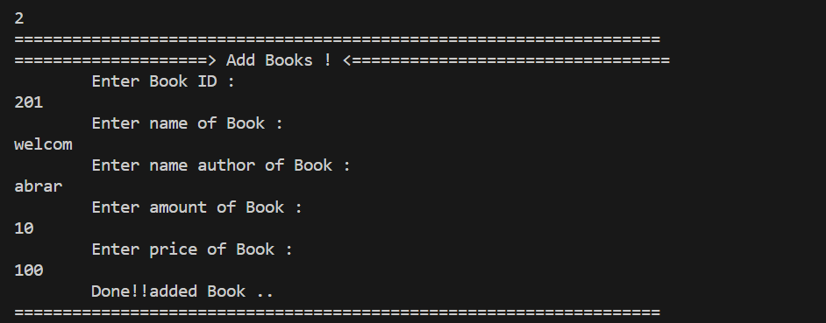
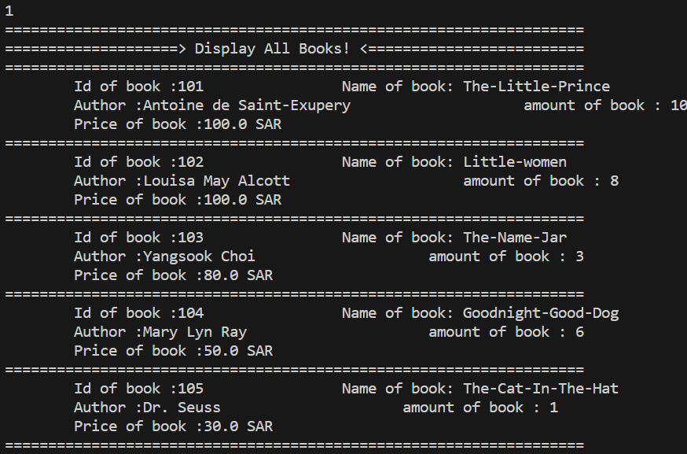
Add Book
Display data of add book

Slide 3


delete Book By Ib
Display data of add book

